Slide 1
Introduction to D3.js
Emily Seibert

Slide 2

Hello!
Software Engineer for 6 years
First time coding was customizing my MySpace template
I studied CS at the UVA Engineering School
I’m most interested in front-end web development
I’m based in SLC, Utah and work remotely!

Slide 3
Industry Experience
Commonwealth Computer Research, Inc.
DoD and ONR, Samsung
Product development for Territory Foods, Inc. (Start up life!)
WillowTree Apps
HBO
CBC
Google
GE
Lionsgate

Slide 4
D3.js
Data-Driven Documents (D3) is a JS visualization library.
“D3 is not a monolithic framework that seeks to provide every conceivable feature. Instead, D3 solves the crux of the problem: efficient manipulation of documents based on data. This avoids proprietary representation and affords extraordinary flexibility, exposing the full capabilities of web standards such as HTML, SVG, and CSS. With minimal overhead, D3 is extremely fast, supporting large datasets and dynamic behaviors for interaction and animation. D3’s functional style allows code reuse through a diverse collection of official and community-developed modules.”
Created by Mike Bostock
Notes:
Today I’ll be speaking about D3, which stands for Data-Driven Documents. D3.js is a JavaScript library used for visualizing data! D3 and I first met in the summer of 2013, during my first internship as a software developer. I was using D3 to build out a data analytics dashboard to compare a company’s profitability margins. Since then, I’ve used D3 on many projects for my employers. Most notably, I built an analytical dashboard for the C-level executives of GE. My web application integrated with a live stream dataset, which was data from factory machines sent to their new cloud interface. Our dashboard updated with each second of data and gave a warning when systems were being overrun in their factories. Here’s a quick snippet of the D3 charts in action!

Slide 5
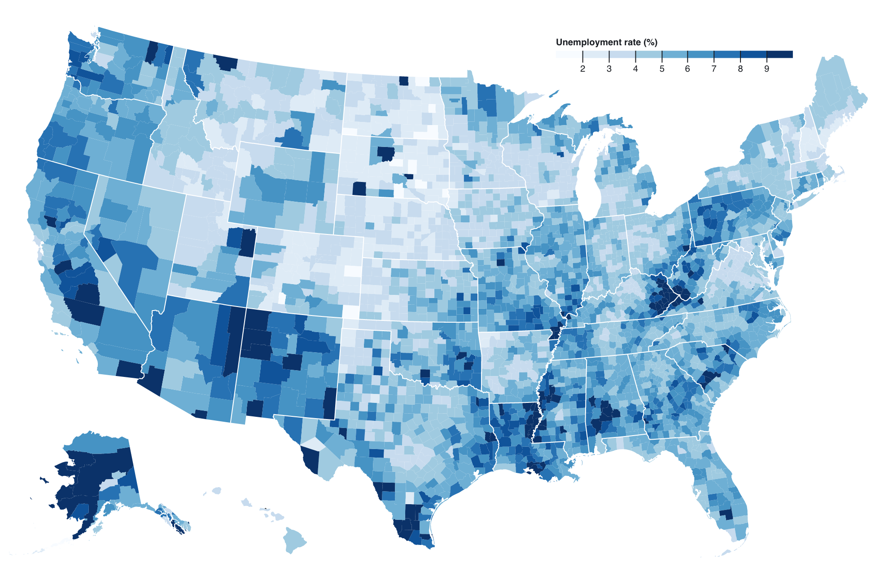
Notes:
https://observablehq.com/@d3/choropleth
https://github.com/d3/d3/wiki/Gallery

Slide 6
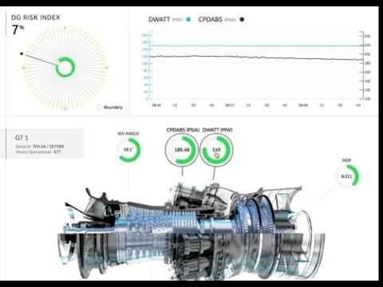
GE: Live factory performance data → D3 Dashboard

Slide 7
Why D3?
Flexibility
Directly manipulates the Document Object Model (DOM)
Low-level access === ability to do anything!
Examples examples examples
Useful for learning, chart inspo, and repurposing
Lightweight
D3 v4 is modular, bring in only what you need. Not necessary to import a full charting library.
Experience
Get yo’ self a job!
Notes:
why did we choose D3 to create these dashboards?
D3 is powerful because of its flexibility. You can create any chart that helps visualize your data because it directly manipulates elements on the Document Object Model (DOM). Many other libraries, such as Plottable, lock developers into a set of charts they may use, limiting customization and creativity! Because we had many unique and complex charts, we needed low-level access to create unique visualizations.
D3 is WIDELY USED aka THOUSANDS of examples. I often joke that I have a professional degree in Googling and this is no exception when it comes to developing charts with D3. There are many examples that you can use as a ‘base’ so that you can focus your time on customized features.
Since you only pull in what you need, D3 is VERY lightweight compared to programs that require their entire library to build a basic chart.
It’s great for getting jobs! D3 is a well-known library and companies often seek out developers who are comfortable working with it. In a world obsessed with data, I wanted to be comfortable with D3. I’ve gotten contracts and job offers from companies interested in my experience with the library. Learn it!

Slide 8
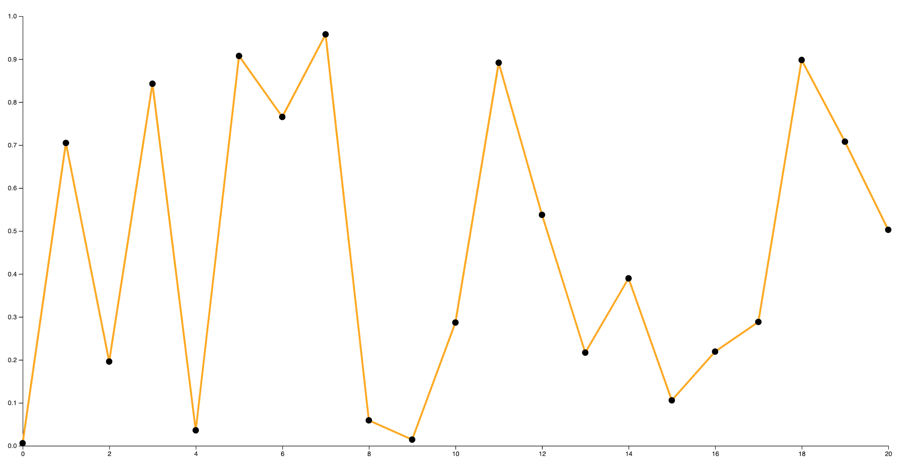
By the end of today you should be:
Comfortable with fundamental SVG
Able to bring D3 into your webapp
Able to read D3 code (useful for those examples!)
Able to create a basic line chart
Notes:
My goal for today is for you all to be familiar with the basic concepts of D3. I want to make this intimidating library approachable by helping you understand a core set of functions to start making your own visualizations. By the end of today’s lecture, you will be able to make your very own D3 line chart.

Slide 9
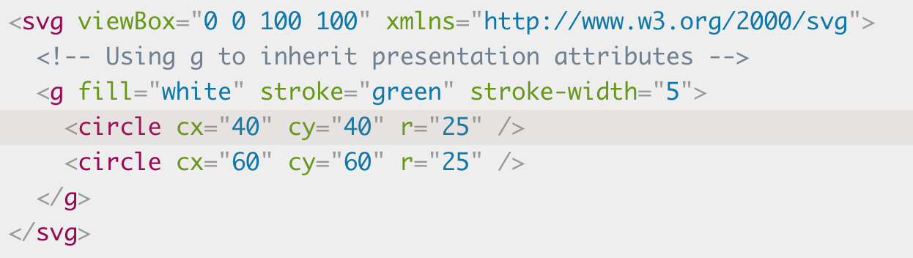
Fundamentals of SVG
SVG = Scalable Vector Graphic
SVG is an XML-based markup language for describing 2D vector graphics.
It’s readable.
Processed natively in the browser when wrapped in HTML: <svg></svg>
Notes:
As I mentioned, D3 directly manipulates elements on the DOM. Let’s dive deeper on this concept. D3 is a collection of helper methods that are built to automate the complicated code to create dynamic, meaningful Scalable Vector Graphics (SVGs).
SVG is an XML-based markup language for describing 2d vector graphics, for example a D3 Chart or an SVG Icon. They are processed natively by modern browsers when wrapped in <svg> HTML element and composed of SVG elements which describe how to draw the SVG.

Slide 10
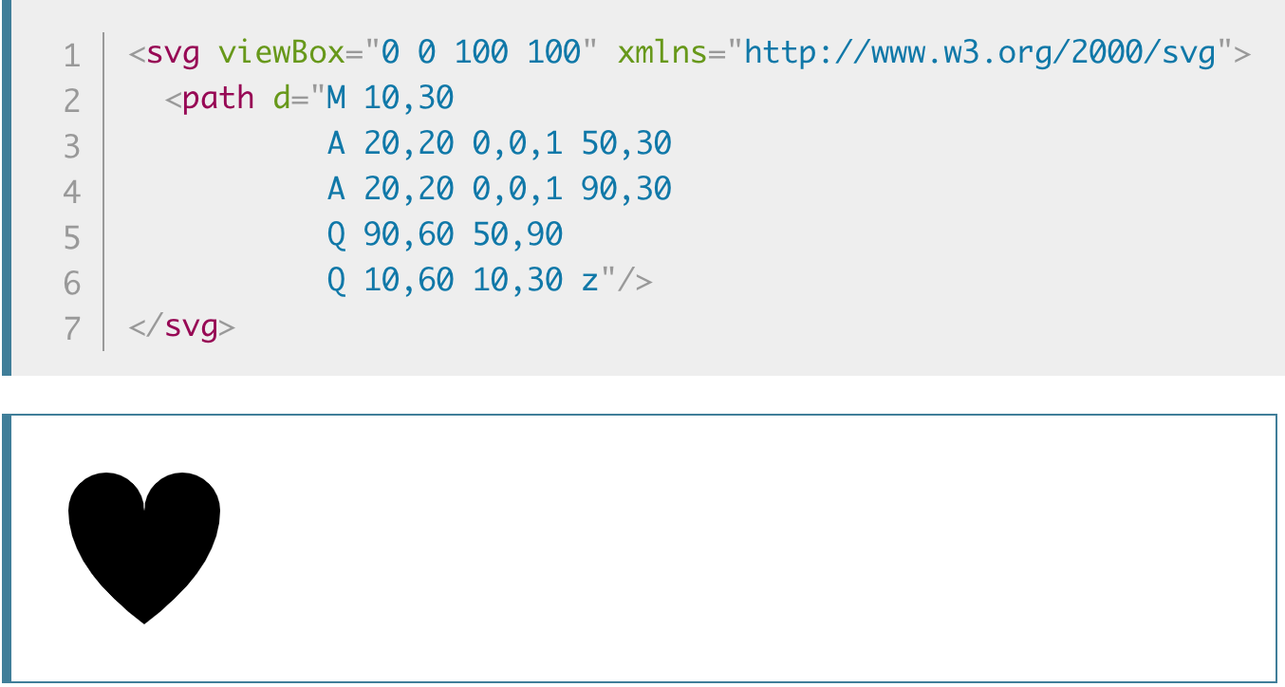
SVG Elements
D3 creates SVGs iteratively using SVG elements such as:
<g> : group other svg elements
<path> : defines shape to be drawn
<rect> : rectangle
<circle> : circle
Notes:
Because D3 creates charts using SVGs, D3 is able to directly manipulate the DOM to modify the chart dynamically. There are many modifications you can make that are covered in the SVG and D3 specs, but let’s take a look at some of the more fundamental SVG elements.
<g> - used for grouping svgs
<path> - used for declaring shapes to be drawn
<rect> - drawing rectangles
<circle> - drawing circles

Slide 11
SVG - Reading Coordinates
In D3, coordinates are used to place tooltips, move axes, place axes labels, etc
0, 0
0, 500
100, 0
100, 500

Slide 12
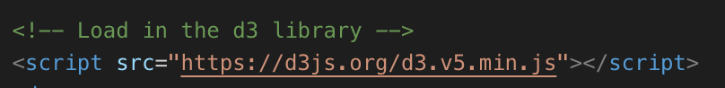
Using D3 - Importing
To use D3, import script into your webapp using npm or direct <script> loading like below.
Notes:
D3 is a library that you pull into your application via <script> in your html file: <script src="https://d3js.org/d3.v5.min.js"></script>

Slide 13
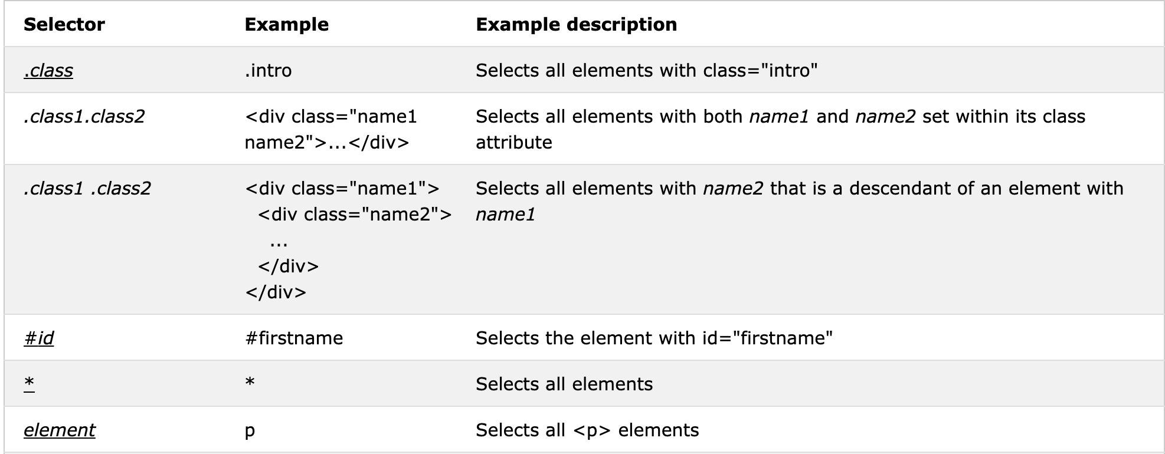
Using D3 - Selection
D3 ‘hooks’ into your application via an HTML element.
Uses CSS selectors to find HTML element to build
Notes:
When creating any D3 chart, you will need to “select” the element in your HTML code you’d like to use as an anchor for your chart. From there, we will use D3 to create chart components such as the Axes, Lines, Points, Tooltips, etc. Selections are a fundamental piece of D3 because it declares what element other functions following will be applied to. Let’s see an example of this.

Slide 14
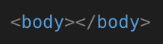
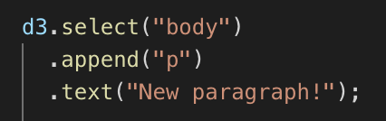
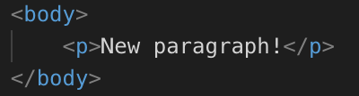
Using D3 - Chaining Functions
D3 → references the d3 object so that we may use the library
.select(“body”) → Returns a reference to the <body> HTML element
.append(“p”) → uses ref to <body> to append <p> inside of HTML element. Returns reference to <p>
.text(“new paragraph!”) → adds text to paragraph.
Notes:
D3 uses a series of chainable functions to manipulate how SVG elements appear on the screen. It’s important to note that the order that functions are called matters - each function returns a selection which is manipulated by the following function. Let’s take a look at our first sample code:
d3.select("body")
.append("p")
.text("New paragraph!");
1. D3 ---> references the D3 object so that we can begin to use the library
2. .select(“body”) → D3 has selection methods that help developers find the exact HTML element they want to build off of. This uses CSS selectors that follow tag, class, and id selections. This returns a reference to the HTML element <body>
3. .append(“p”) → Using the reference to <body>, append an HTML element <p> to the <body> and then return a reference to the <p>.
4. .text → using the reference to <p>, apply text to the paragraph HTML element

Slide 15
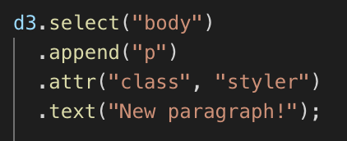
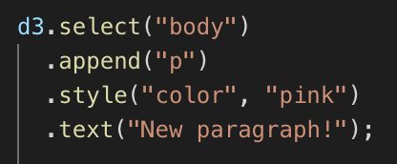
Using D3 - Styling
Many functions can be ‘chained’ in addition to the above
Styling can be done via:
setting an attribute or style property on the element
CSS by setting a class on the element
Notes:
As we are creating SVG elements, we can also apply attributes to our HTML elements, which we can update via styling in CSS. This is particularly important for setting initial styling as general convention is to set default styles via CSS and override styles using .style and .attr functions in D3.
Let’s look at creating a basic line chart in D3 by iteratively creating chart components.

Slide 16
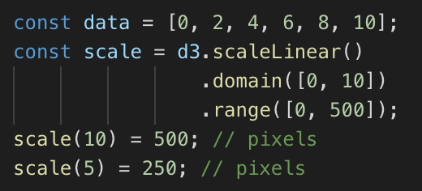
Using D3 - Scaling
We need to create scale functions that take an input (data value) and return a value such as a coordinate.
Input = “domain”, output = “range”
https://www.d3indepth.com/scales/

Slide 17
Coding Time

Slide 18
You do it!
https://github.com/emilyseibert/d3-lecture

Slide 19
Resources
http://elliotbentley.com/2017/08/09/a-better-way-to-structure-d3-code-es6-version.html
https://bl.ocks.org/gordlea/27370d1eea8464b04538e6d8ced39e89#index.html
https://d3js.org/
https://github.com/d3/d3/wiki/Gallery
https://www.indeed.com/q-D3-Js-jobs.html
https://www.glassdoor.com/Job/data-visualization-developer-javascript-d3-js-jobs-SRCH_KO0,45.htm
https://developer.mozilla.org/en-US/docs/Web/SVG
https://www.w3schools.com/cssref/css_selectors.asp
https://www.d3indepth.com/scales/

Slide 20
Q & A:
Introduction to D3
Emily Seibert

